Slide 1
Collections
Arrays:
Student[] s = new Student[10000];
S[0] = new Student();
S[1] = new Customer(); /// CE incompatible types found : customer, required Student.
Limitations Of Array:
Arrays are fixed size .
Arrays can hold only homogenious datatypes

Slide 2
Arrays
Arrays are fixed in size i.e once we creates an array we can’t increase or decrease the size based on our requirement
With respect to memory arrays are not recommended
To use
III. With respect to performance arrays are recommended use.
IV . Arrays can hold only homogeneous data type elements.
Collections
I. Collections are growable in nature i.e. based on our requirement we can increase or decrease the size
II. With respect to memory collections are recommended to use
III. With respect to performance collections are not recommended to use.
IV. Collections can hold both heterogeneous and homogeneous elements .
V. There is no underlined data structures for arrays and hence
Ready made method support is not available. For Every requirement we have to write the code explicitly.
Which increases complexity of programming.
VI.Arrays can hold both primitives and objects
V. Every collection class is implemented based on some standard data structures and hence for every requirement ready made method support is available . Being a programmer we can use these methods directly .and we are not responsible to implement those methods .
VI. Collections can hold only object types not primitives.

Slide 3
Collections :
If we want to represent a group of individual object as a single entity then we can go for collections.
Collection Framework :
It contains several classes and interfaces which can be used to represent a group of individual objects as a single entity.
Java and C++
Java
Collection
Collection Framework
C++
Container
STL
(Standard Template Library )

Slide 4
9 Key Interfaces of Collection Framework
I. Collection
II. List
III. Set
IV. SortedSet
V. NavigableSet
VI. Queue
VII. Map
VIII. SortedMap
IX. NavigableMap

Slide 5
Collections(I)
I. If we want to represent a group of individual objects of a single entity is known as collection.
II. Collection Interface defines the most common methods which are applicable for any collection object.
III. In general collection interface is considered as root interface of collection framework.
IV. There is no concrete class which implements collection interface directly.
Difference between collection and collections ?
Collection is an interface. If we want to represent a group of individual object as a single entity. Then, we should go for collection.
Collections is an utility class present in Java.util package to define several utility methods for collection objects like sorting,searching etc..

Slide 6
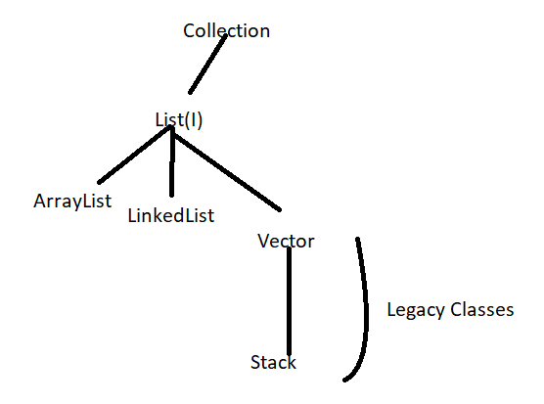
List(I)
It is the child interface of collection if we want to represent a group of individual object as a single entity where duplicates are allowed and insertion order must be preserved then we should go for list.
Note:
In 1.2 v vector and stack classes are re-engineered to implement list interface.
Version 1.0

Slide 7
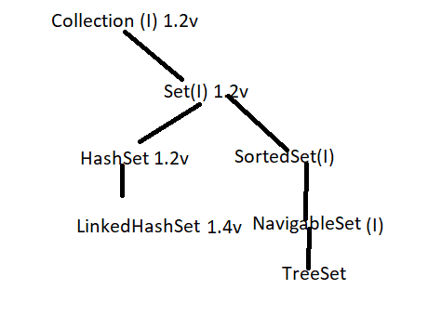
Set(I)
It is the child interface of collection if we want to represent a group of individual object as a single entity where duplicates are not allowed and insertion order not required then we should go for set.
SortedSet(I)
It is child interface of Set . If we want to represent a group of individual object as a single entity where duplicates are not allowed and all objects should be inserted according to some sorted order then we should go for SortedSet.
NavigableSet(I)
It is the child interface of SortedSet it contains several methods for navigation purposes.
1.6v
1.2v

Slide 8
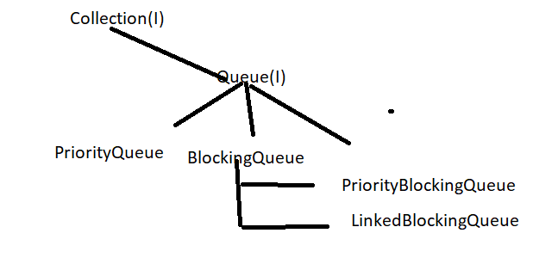
Differences Between List and Set ?
List | Set
I. Duplicates are allowed | Duplicates are not allowed
II. Insertion order preserved | Insertion order not preserved.
Queue(I)
It is the child interface of collection . If we want to represent a group of individual object prior to processing then we should go for queue. Usually queue follows First In First Out order but based on our requirement we can implement our own priority order also. Before sending a mail all mail ids we have to store in some data structure in which order we added mail ids in the same order only. Mail should be delivered . For this requirement queue is best choice.
1.5v
Note:
All the above interfaces (Collection,List,Set, SortedSet,NavigableSet and Queue ) meant for representing a group of individual object. If we want to represent a group of individual object as Key : Value pair then we should go for Map

Slide 9
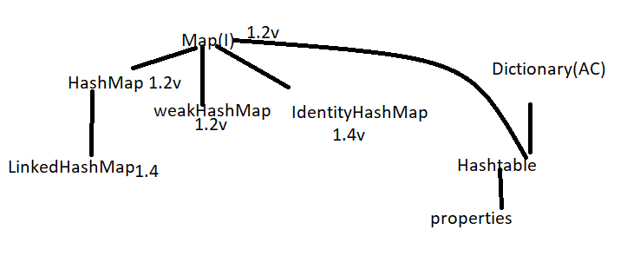
Map(I)
Map is not child interface of collection . If we want to represent a group of objects as key:value pair then we should go for map
Key(RollNo) | Value
I.101 | Akhil
II. 102 | Durga
III. 103 | Shivani
Both keys and values are objects only . Duplicate keys are not allowed but values can be duplicated.
1.0v Legacy classes

Slide 10
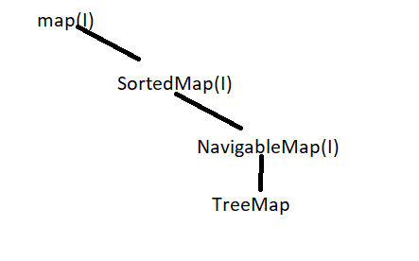
SortedMap(I)
It is the child interface of Map. If we want to represent a group of key value pair according to some sorting order of keys
Then we should go for SortedMap . In sortedmap the sorting should be based on key but not based on value.
NavigableMap(I)
It is the Child interface of sorted map it defines several methods for navigation purposes.
1.2v
1.6v
1.2v

Slide 11
Sorting
1.Default Nature of sorting order :- Comparable
2. Customized sorting order : Comparator Interface .
If we want to access collection object one by one
Then we should go with :
1.Enumeration(I) == Legacy classes
2.Iterator(I)
3.ListIterator(I)
If we want to use utility classes :
1.Collections
2. Arrays.
The following are legacy characters present in collection framework.
Enumeration(I),Dictionary(AC),Vector(c),Stack (C),Hashtable(C),Properties(C)

Slide 12
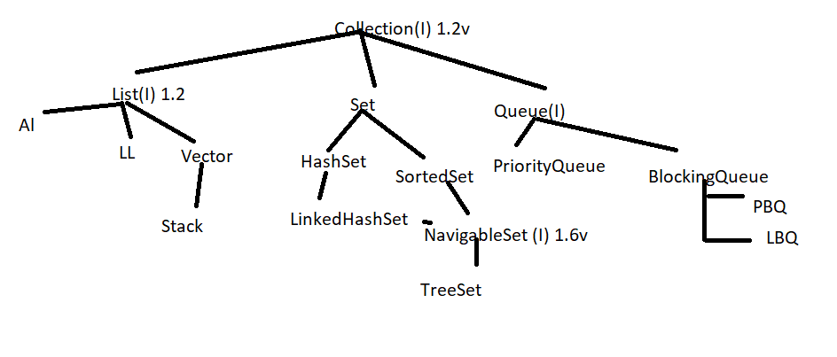
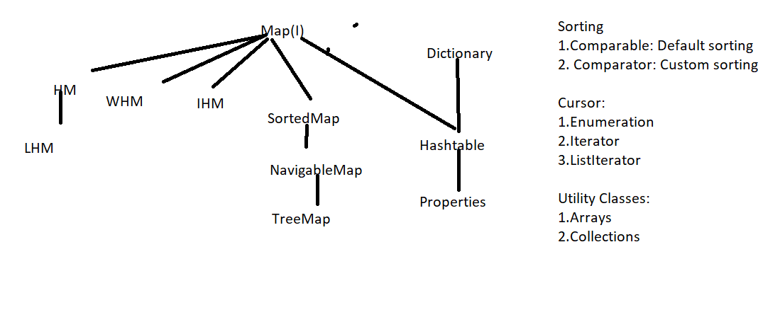
1.5v

Slide 13
Interview Questions :
1.Difference between collection and collections
2. Difference between List and Set
3. Difference between Collection and Map
Collection(I)
If we want to add a group of individual object as a single entity . Then , we should go for collection.
Collection interface defines the most common method which are applicable for any collection object .
Methods:
boolean add(Object o)
boolean addAll(Collection c)
boolean remove(Object o)
boolean removeAll(Collection c)
void clear()
boolean retainAll(Collection c) To remove all objects except those present in c
boolean contains(Object o)
boolean containsAll(Collection c)
boolean isEmpty()
int size()
Object[] toArray()
Iterator iterator()

Slide 14
Note :
There is no concrete class which implement Collection class directly.
List(I)
I. List is the child interface of Collection
II . If we want to represent a group of individual object as a single entity where duplicates are allowed and insertion order must be preserved then we should go for List
III. Insertion order is preserved with respect to index. We can differentiate duplicate object by using index. Hence, In List index play very important role
IV. List Interface defines the following specific methods .
void add(int index , Object o)
boolean addAll(int index , Collection c)
Object remove(int index )
Object get(int index )
Object set(int index , Object o ) to replace the element present at specified index with provided object and returns the old object
int indexOf(Object o ) returns index of first occurrence of ‘o’
int lastIndexOf(Object o )
Cursor:
ListIterator listIterator()

Slide 15
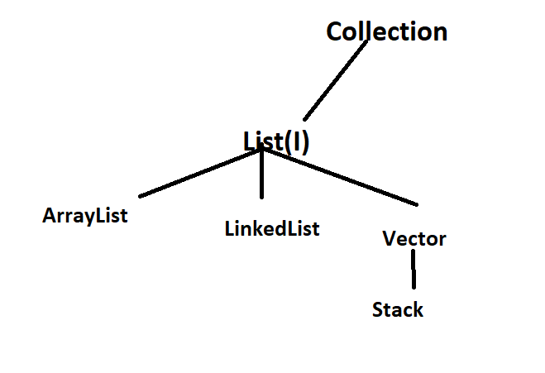
ArrayList
Resizable Array or growable array
Duplicates are Allowed
Insertion order preserved .
Heterogeneous Objects are allowed except (treeset and treemap)
Null Insertion is possible

Slide 16
Underlined data structure is resizable or growable array
Duplicate objects are allowed
Insertion order is preserved
Heterogeneous objects are allowed (except Treeset and TreeMap everywhere Heterogeneous objects are allowed )
Null insertion is possible
Contructors
ArrayList l = new ArrayList();
Newcapacity = (current capacity*3/2)+1 == default capacity == 10 ,16,25
ArrayList l = new ArrayList();
Creates an empty arrayList object with default initial capacity 10
Once ArrayList reaches its maximum capacity Then a new arrayList object will be created with
new capacity = (current capacity*3/2)+1
2. ArrayList l = new ArrayList(int initial capacity );
Creates empty arraylist object with specified initial capacity

Slide 17
3. ArrayList l = new ArrayList(Collection c);
Creates an equivalent arrayList Object for a given collection
1. Usually we can use collection to hold and transfer objects from one location to another location (Container) to provide support for this requirement every collection by default implements serializable and cloneable interface
2. ArrayList and vector classes implements RandomAccess interface so that any random element we can access with the same speed .
RandomAccess
Randomaccess interface present in java.util package and it doesn’t contain any method it I a marker interface where required ability will be provided by the jvm
ArrayList is the best choice if our frequent operation is retrieval operation (because arratlist implements randomaccess interface . ArrayList is the worst choice if our frequent operation is insertion and deletion in middle .

Slide 18
Differences between ArrayList and vector ?
ArrayList | Vector
Every Method present in the arraylist is non-synchronised | Every method present in vector is synchronized
At a time multiple threads are allowed to opearate on arraylist object and hence it is not thread safe | At a time only one thread is allowed to operate on vector object and hence it is thread safe
Relatively performance is high because threads are not required to wait to operate on arrayList object | Relatively performance is low because threads are required to wait to operate on vector object
Introduced in 1.2 v and it is non-legacy | Introduced in 1.0 v and it is legacy

Slide 19
How to get syncronised version of ArrayList Object ?
By default ArrayList is non-synchronized but we can get synchronized version of Arraylist object by using sychronisedList() method of Collections class
ArrayList l = new ArrayList();
List l1 = Collections.synchronizedList(l);
public static List synchronizedList(List l );
Similarly we can get synchronized version of Set and Map objects by using following methods of Collections class
public static Set synchronizedSet(Set s)
public static Map synchronizedMap( Map m)

Slide 20
LinkedList
The underlined data structure is doubly LinkedList .
Insertion order is preserved .
Duplicate objects are allowed.
Heterogeneous objects are allowed except treeset and treemap
Null insertion is possible .
LinkedList implements Seriazable and cloneable but not randomaccess.
LinkedList is the best choice if our insertion and deletion in the middle.LinkedList is the worst choice if our frequent operation is retrieval operation .
Constructors :
LinkedList l = new LinkedList();
Creates an empty linkedlist object
LinkedList l = new LinkedList(Collection c);
Creates an equivalent linkedList object for the given collection

Slide 21
LinkedList Class Specific Methods :
Usually we can use LinkedList to develop stacks and queues to provide support for this requirement,LinkedList Class defines the following specific methods.
void addFirst(Object o);
void addLast(Object o);
Object getFirst()
Object getLast();
Object removeFirst()
Object removeLast();
Differences between ArrayList and LinkedList.
ArrayList | LinkedList
ArrayList is the best choice if our frequent operation is retrieval operation | LinkedList is the best choice if our frequent operation is insertion and deletion in the middle.
ArrayList is the worst choice if our frequent operation is insertion and deletion in the middle .because Internally several shift operations are performed. | LinkedList is the worst choice if our frequent operation is retrieval operation
In ArrayList elements are stored in consecutive memory location. Hence retrieval operation becomes easy . | In LinkedList element won’t be stored in consecutive memory location .Retrieval operation will become complex.

Slide 22
Vector
1.The underlined datastructure is resizable array or growable array .Inserion order is preserved. Duplicates are allowed .
2. Heterogeneous objects are allowed.
3.Null insertion is possible .
4. It implements serializable ,cloneable and randomaccess interfaces.
5. Every method present in a vector is synchronized and hence vector is thread safe .
Contructors:
Vector v = new Vector();
Creates an empty vector object with default initial capacity 10 .
Once Vector reaches its max capacity a new vector object will be created with
New Capacity = Current Capacity *2
2. Vector v = new Vector(int initial capacity);
Creates an empty vector object with specified initial capacity.

Slide 23
3. Vector v = new Vector(int initialcapacity,int incrementalcapacity )
4. Vector v = new Vector(Collection c )
Creates an equivalent vector object for the given collection . This Constructor meant for interconversion between collection objects
Vector Specific Methods:
To add Objects
add(Object o ) -------- C;
Add(int index , Object o) ----→ L
addElement(Object o) ===➔ Vector
To Remove objects :
remove(Object o) ===== C
removeElement(Object o) ======= V
remove(int index) ======= L
removeElementAt(int index) ======= V
clear() ======= C
removeAllElements() ===== V

Slide 24
To get Objects :-
Object get(int index) ======== L
Object elementAt(int index) ======= V
Object firstElement() ==== V
Object lastElement() ===== V
Other Methods
int size()
int capacity()
Enumeration elements();

Slide 25
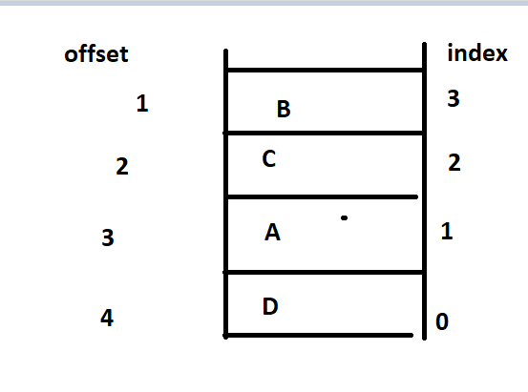
Stack
It is a child class of vector .it is a specially designed class for LIFO(Last In First Out)
Constructors :
Stack st = new Stack();
Stack Specific Methods
Object push(Object o) === to insert an object into the stack
Object pop() = == to remove and return top of the stack
Object peek() === to return top of the stack without removal
boolean empty() == returns true if stack is empty
int search(Object o) ==== returns offset if the element is available otherwise returns (-1)
For example st.search(D) === 4
St.search(2) ==== -1

Slide 26
import java.util.*;
class StackDemo{
public static void main(String[] args){
Stack s = new Stack();
s.push("A");
s.push("B");
s.push("C");
System.out.println(s); // [A,B,C]
System.out.println(s.search("A")); // 3
System.out.println(s.search("Z")); // -1
}
}

Slide 27
The 3 Cursors of Java : -
If we want to get objects one by one from the collection then we should go for cursor .
There are three types of cursors available in java
Enumeration
Iterator
ListIterator
Enumeration :
Enumeration e = v.elements();
While(e.hasmoreElements())
{
Integer I = (Integer) e.nextElements();
if(i%2 ==0)
System.out.println(I)
}
System.out.println(v)

Slide 28
What is the need of Enumeration ?
Ans . We can use enumeration to get Objects one by one from legacy Collection object .
We can create Enumeration object by using elements method of Vector class;
public Enumeration elements();
Eg . Enumeration e = v.elements();
// v is the vector Object
Methods of Enumeration :
public boolean hasMoreElements();
public Object nextElement();

Slide 29
Limitations of Enumeration :
We can apply enumeration concept only for legacy classes and it is not a universal cursor.
By using enumeration we can get only read access and we can’t perform remove operation
To Overcome above limitation we should go for Iterator .
Iterator:-
We can apply iterator concept for any collection object . And hence it is universal cursor .
By using Iterator we can perform both read and remove operations .
How we can get Iterator Object?
we can create Iterator object by using iterator() method of collection interface .
public Iterator iterator();
Iterator itr = c.iterator() // where c is any collection object .

Slide 30
Methods of Iterator:
public boolean hasNext();
public Object next();
public void remove()
ArrayList al = new ArrayList();
for(int i = 0;i<=10;i++){
al.add(i); }
Sop(l);
Iterator itr = al.iterator();
While(itr.hasnext()){
Integer I = (Integer) itr.next();
if(I%2==0)
Sop(I);
else
itr.remove(); // this is the advantage over Enumeration .
}
Sop(al);
//[0,2,4,6,8,10]

Slide 31
Limitations of Iterator:
By using enumeration and iterator we can always move only towards forward direction and we can’t move towards backward direction . These are single directional cursor but not bidirectional cursor .
By using Iterator we can perform only read and remove operation and we can’t perform replacement and addition of new objects
To overcome above limitations we should go for ListIterator;
ListIterator :-
By using ListIterator we can move either to the forward direction or to the backward direction . And hence it is bi-directional cursor .
By using ListIterator we can perform replacement and addition of new objects in addition to read and remove operation .
We can create ListIterator by using listIterator() method of List(I) Interface .
public ListIterator listIterator();
ListIterator ltr = l.listIterator(); // where l is any list object

Slide 32
Methods Of ListIterator :
1. ListIterator is the child interface of Iterator and hence all methods present in iterator by default available to the ListIterator .
2. ListIterator defines the following 9 methods :
public boolean hasNext();
public Object next(); Forward movement
public int nextIndex();
Public Boolean hasPrevious();
Public Object previous(); Backward Movement
Public int previousIndex();
Public void remove();
Public void add(); Extra Operation
Public void set(Object o);
Note :
The most powerful cursor is ListIterator , But its limitation is it is applicable only for list Objects .

Slide 33
Comparison table of Three cursors :
Property | Enumeration | Iterator | ListIterator
Where we can apply | Applicable only for legacy classes | Applicable for any collection | Only for list Objects
Is it legacy ? | Yes (1.0v ) | No(1.2) | No (1.2 v)
Movement | Single direction(only forward direction) | Single direction(Only forward direction) | Bi-directional
Allowed operation | Only read | Read/remove | Read|remove|replace|add
How we can get | By using elements() of vector class | By using iterator() of Collection(I) | By using ListIterator() of List(I)
Methods | 2methods hasMoreElements() nextElements() | 3 Methods hasNext() Next() Remove() | 9 methods

